Slide 1

Period Product Initiative
By your Student Government

Slide 2
The SGA’s Journey

Slide 3
Last year to now
Fall 2022
Initiative was started by small club, “Progressive Minds”
Fall 2022 / Spring 2023
No tangible support, by the end of the semester the initiative ended.
Now
The initiative was left at a great place to be revamped by the SGA

Slide 4
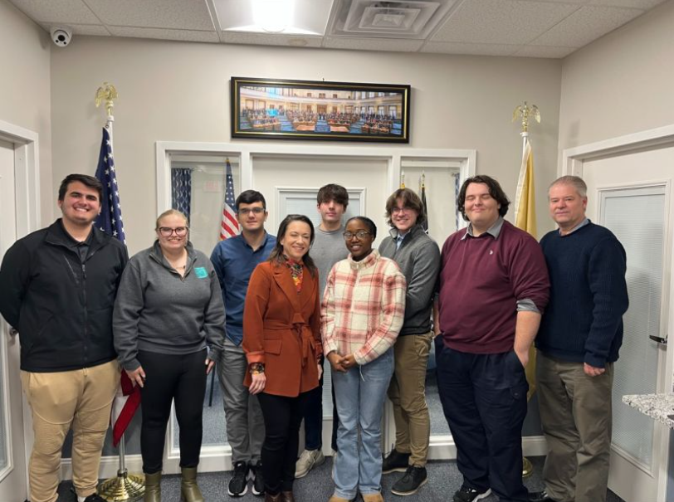
State Policy
On 06/30/23 the NJ State Assembly and Senate voted to pass the bill (S-1221/A-1349) which “Establishes program in DOE to reimburse school districts for providing menstrual products in certain public schools and requires State to pay costs”
2021 study commissioned by Thinx and PERIOD provided eye-opening data
We met with Assemblywoman Dunn about our initiative and this recent policy

Slide 5
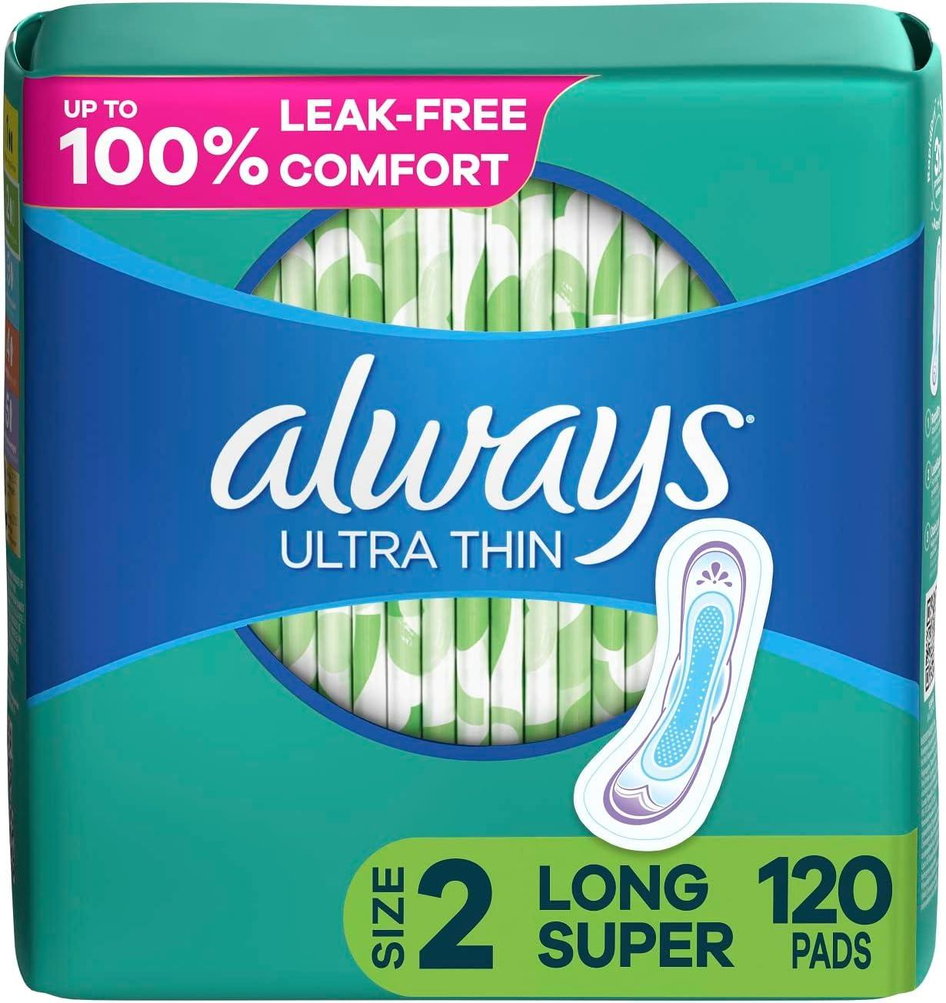
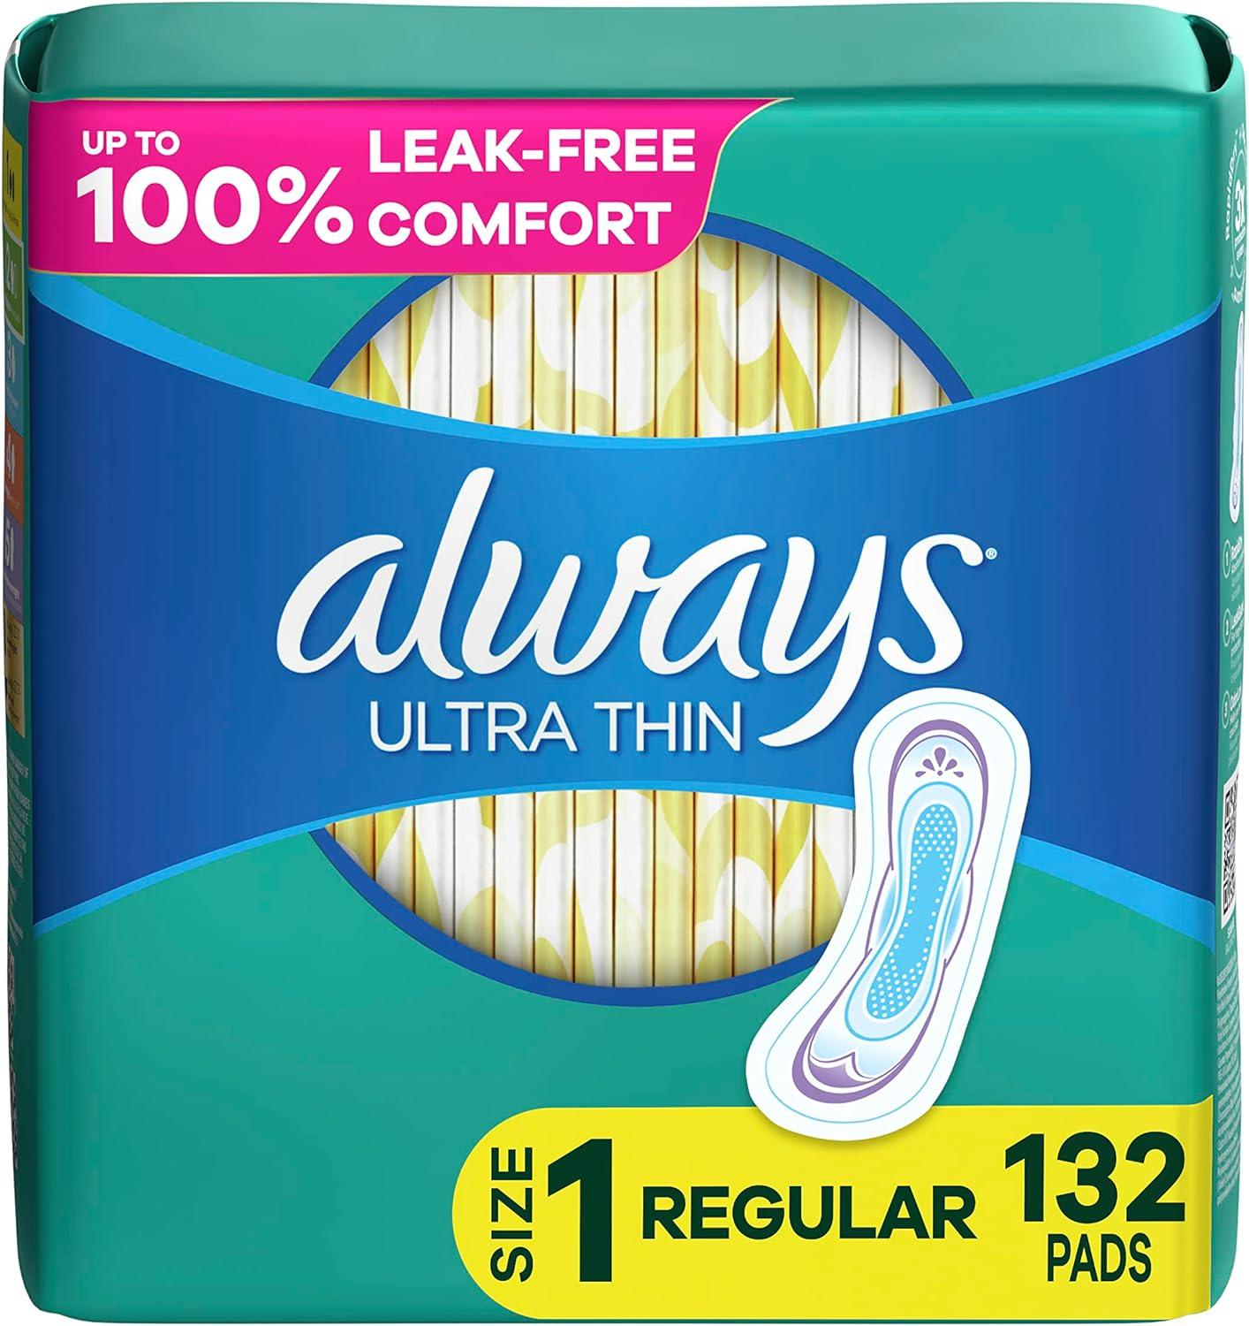


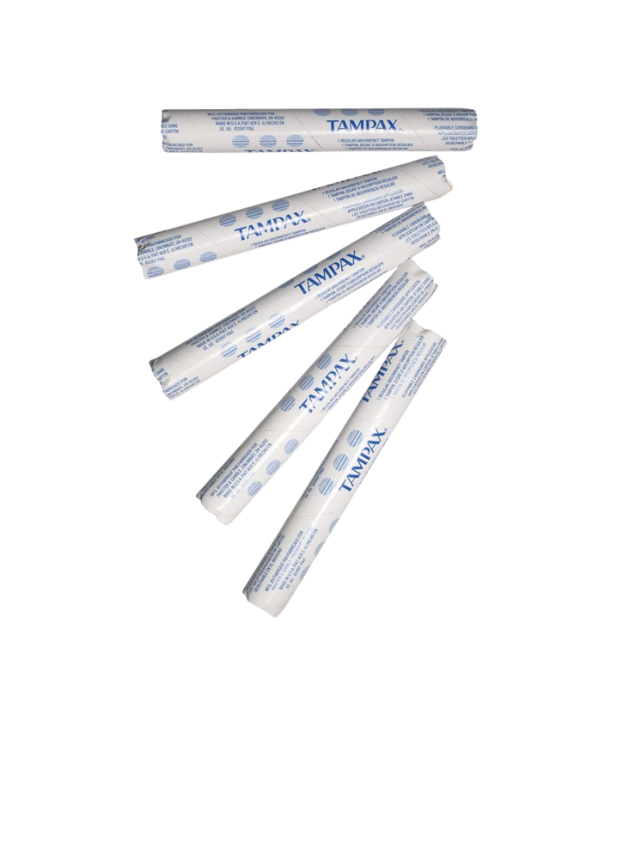
September-October:
Developing Support
& Direction
3
Research
Marketing
Roll Out
1
Researched and confirmed a purchase option
Developed a Marketing Plan
Had everything prepared and rolled out on October 30th
2

Slide 6



October: Fundraising
Hosted an Empanada and Bracelet Fundraiser
Organized a Tie-Dye Fundraiser
Put together an On-The-Go Bake Sale
United Latino Organization
Feminist Empowerment Organization
Student Government Association
On Campus Fundraising

Slide 7

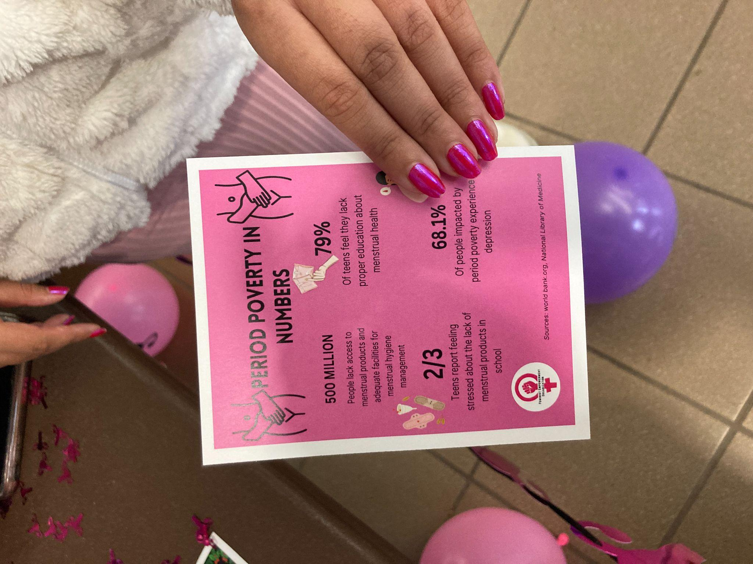

November-December
Data Collection & Destigmatization
Period Party Goals:
Destigmatize the topic of menstruation
Educate people on menstruation and Period Poverty
Raise awareness around the initiative
Ensure students were aware of the free menstrual products on campus

Slide 8
Free Products Usage Frequency and Cost
Measure | Tampons | Pads S-1 | Pads S-2
Starting Total | 2500 | 1320 | 504
Total Used | 565 | 500 | 232
% of Total Used | 43.56% | 38.55% | 17.89%
Weekly Average | 113 | 100 | 46.4
Estimated Annual | 9605 | 4250 | 1972
Cost | Tampons | Pads S-1 | Pads S-2
Per unit | $ 0.11 | $ 0.13 | $ 0.16
Total | $ 59.61 | $ 63.85 | $ 36.73
% of Total | 37% | 40% | 23%
Weekly Average | $ 11.92 | $ 12.77 | $ 7.35
Estimated Annual | $ 506.69 | $ 542.73 | $ 312.21

Slide 9
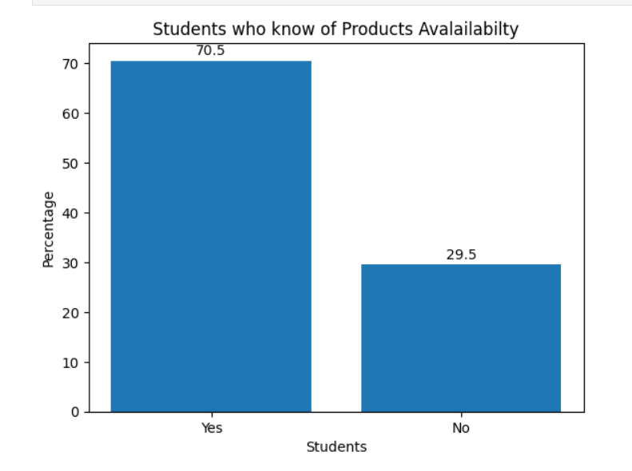
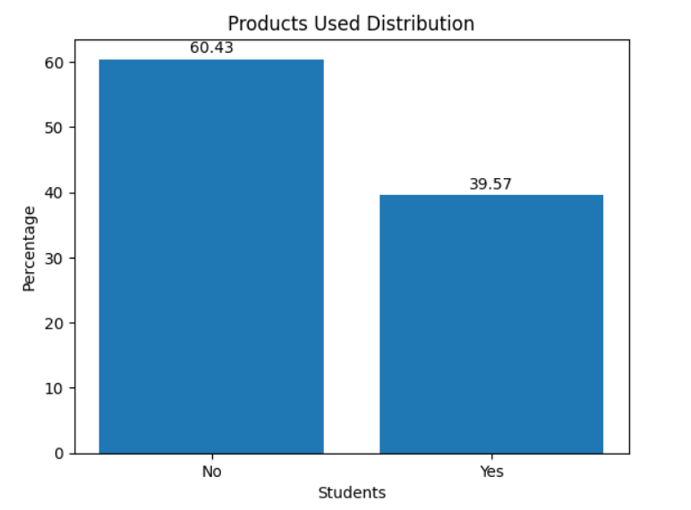
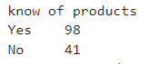
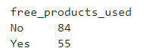
Outreach

Slide 10
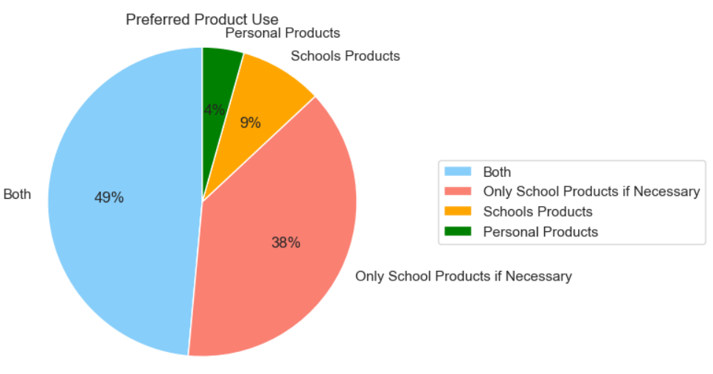
Distribution of Products Usage Sources
Distribution of Products Usage Sources

Slide 11
Student Survey

Slide 12
Methodology (Data Collection)
Began on 11/13/23
Ended on 12/8/23
Collected 213 Student Surveys
Mass Email and QR code
Promotion during Events
In-Person data collection
Survey Duration:
30 seconds-2 minutes
3 Avenues for Data Collection:

Slide 13
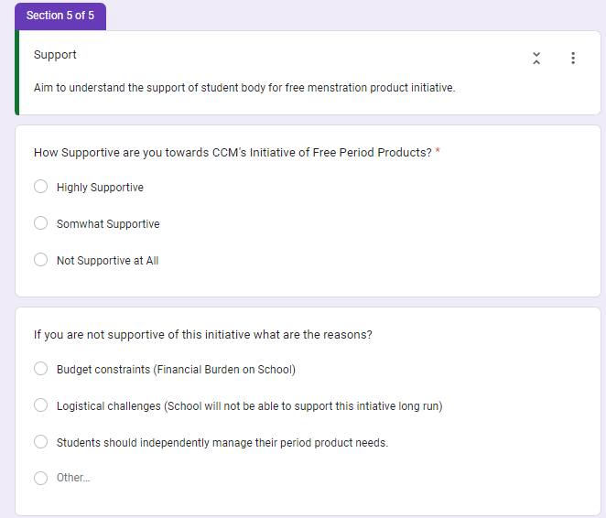
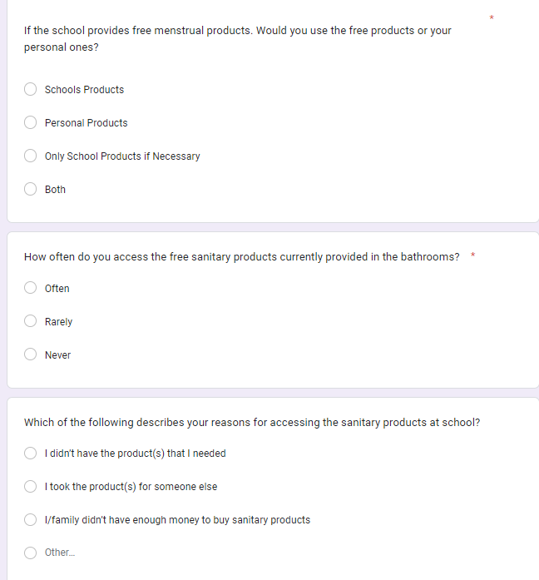
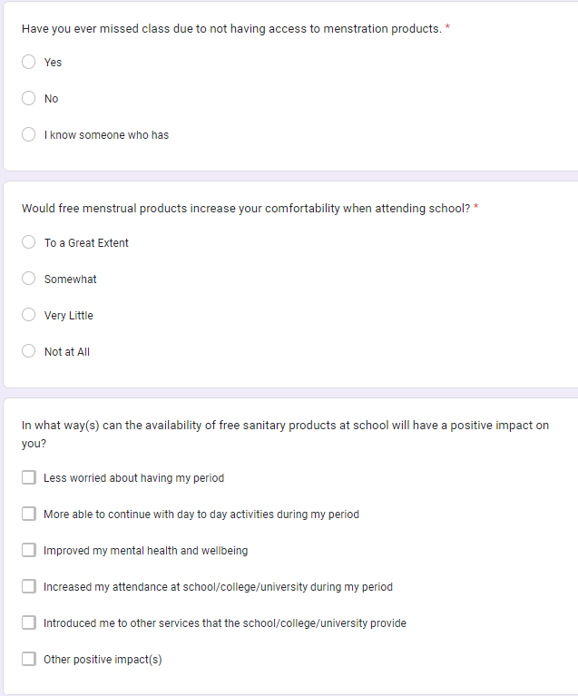
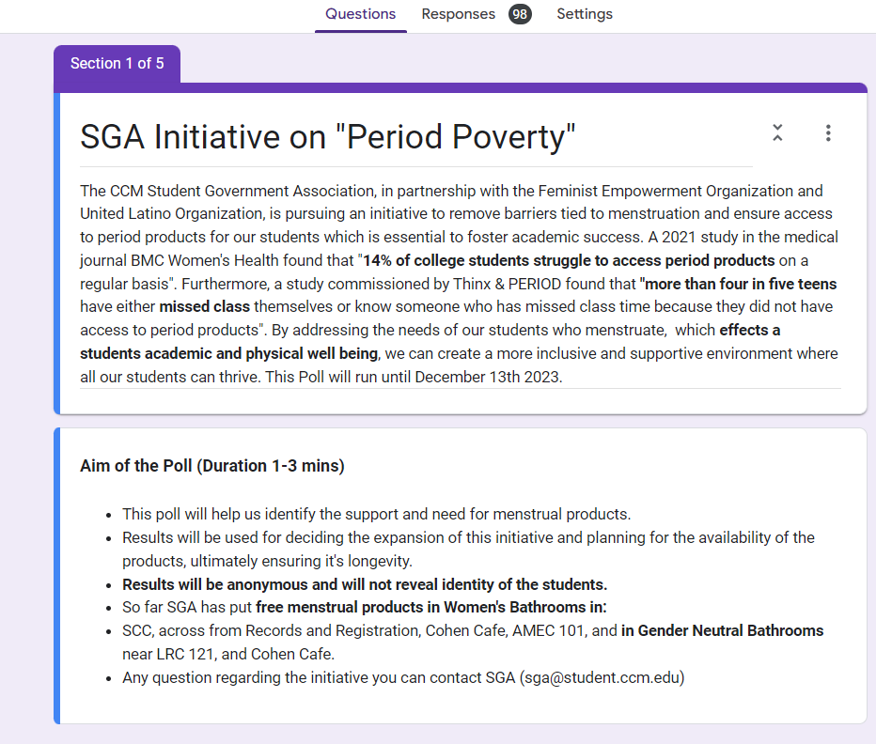
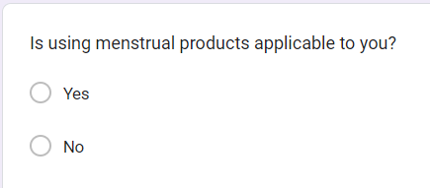
Survey Question
Demographic Questions
Menstruation Product Usage
Menstruation Product Impact
Menstruation Product Support

Slide 14
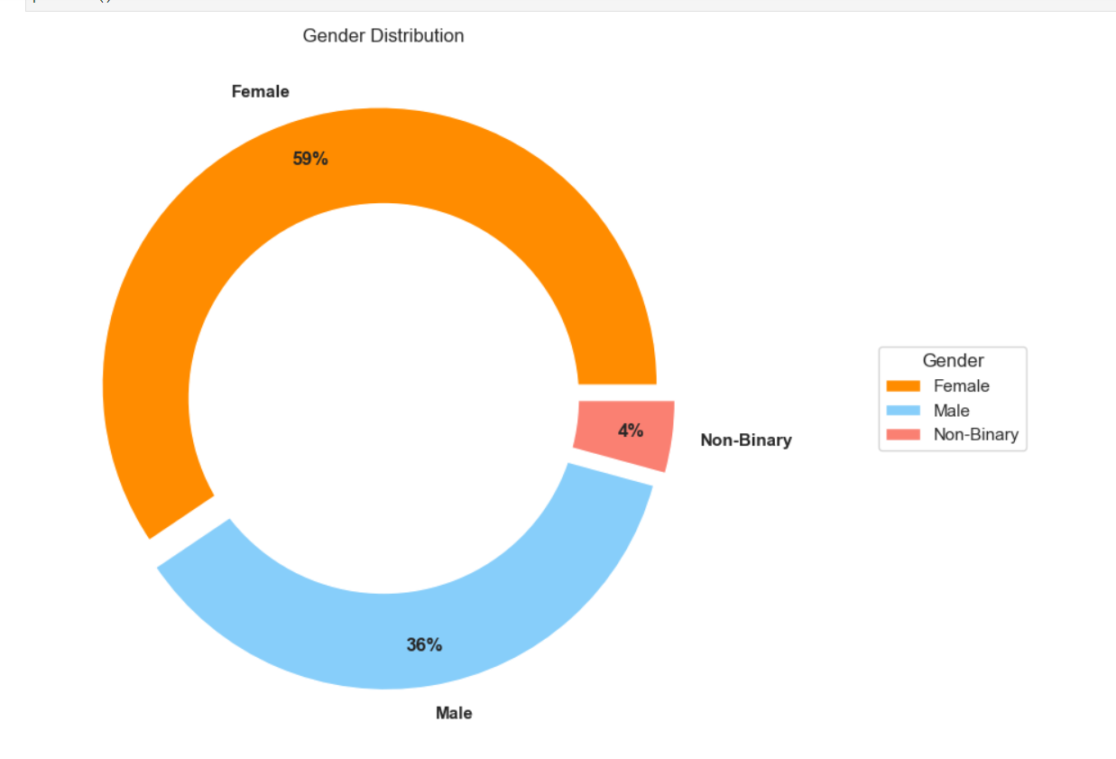
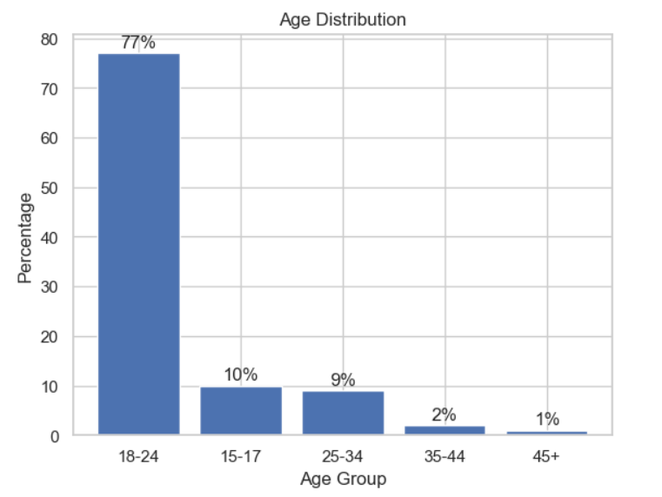
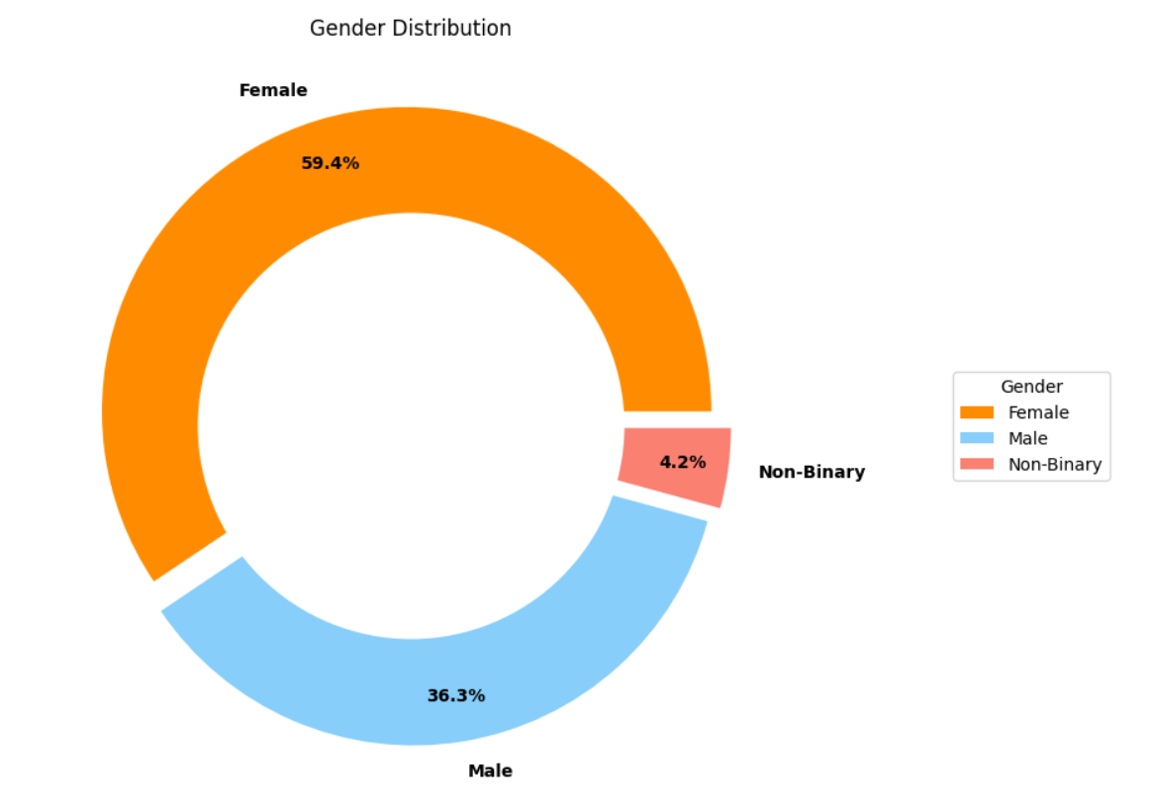
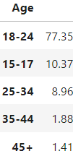
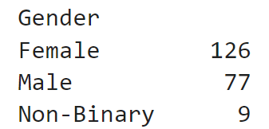
Survey Demographics
About 60% of survey were female students
Participant were predominantly 18-24 of age (78%)
Gender Distribution
Age
Distribution
Notes:
The survey data although not fully but colosely alligns with the CCM's statistics from National Education Center for Statistics which reveals the demographics to be 24 and under (78%). 44 % full time and 47% female.

Slide 15
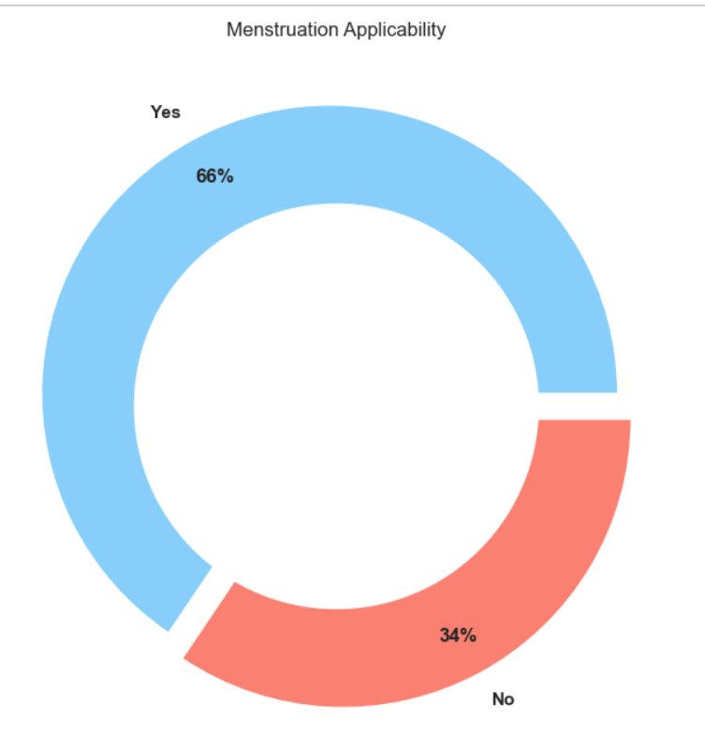
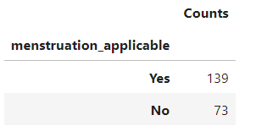
Menstruation Applicability
For 66% of the participants menstruation was applicable
This include students who identify as female, male, or non binary

Slide 16
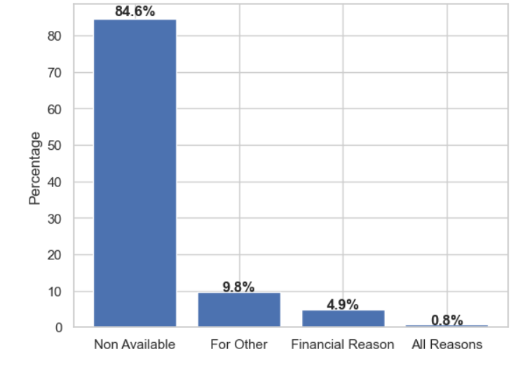
Reasons of Product Usage
Biggest reason:
Not Available Personally or For Other (94%)

Slide 17
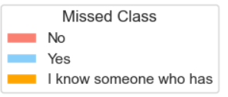
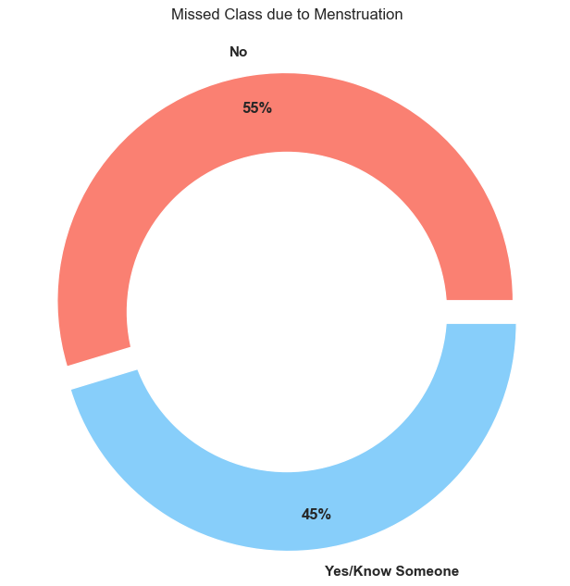
Impact of Menstruation Products
Missed Class due to Menstruation
45% of students have missed classed or know someone who has
63 students of the 139

Slide 18
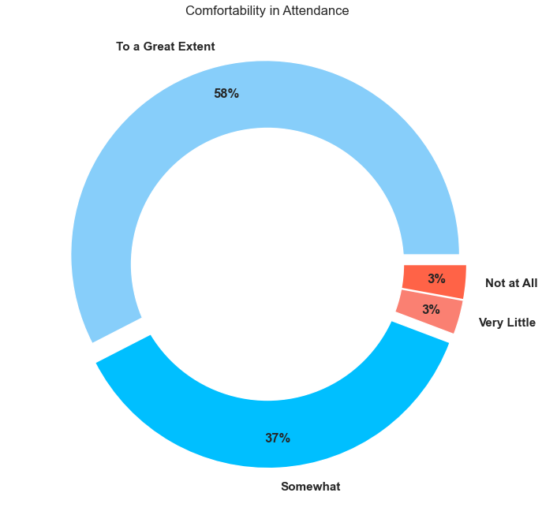
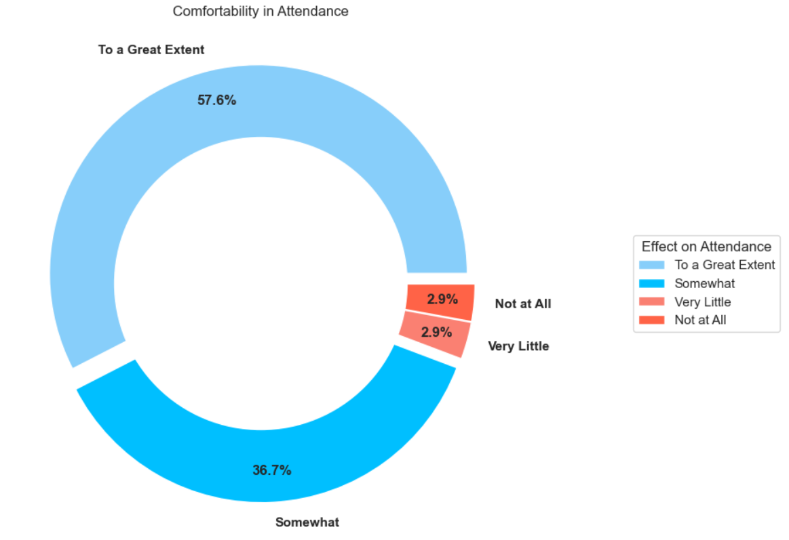
Comfortability in Attendance
Majority of the students see this initiative increasing their comfortability in attending classes To a Great Extent (58%)

Slide 19
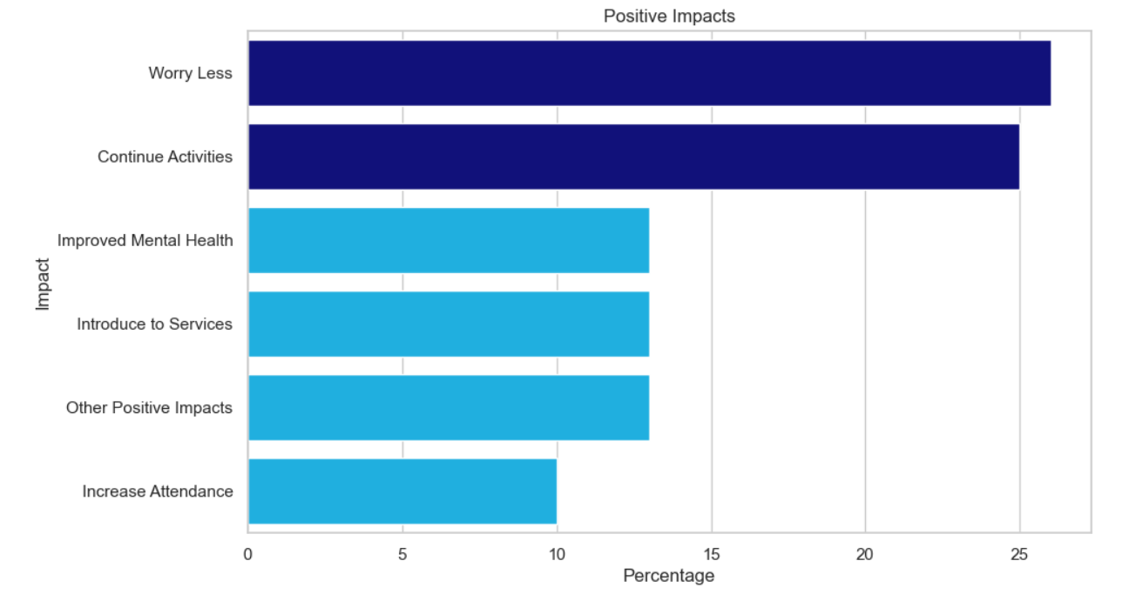
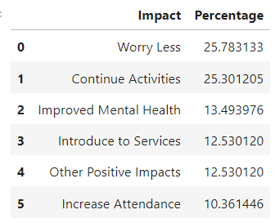
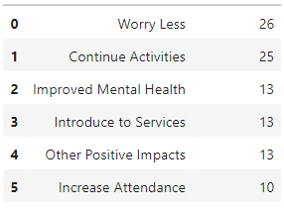
Major Positive Impacts
Half of the students see the free products:
Helping them continue their daily activities more comfortably
Decreasing the mental burden of carrying products on hand

Slide 20
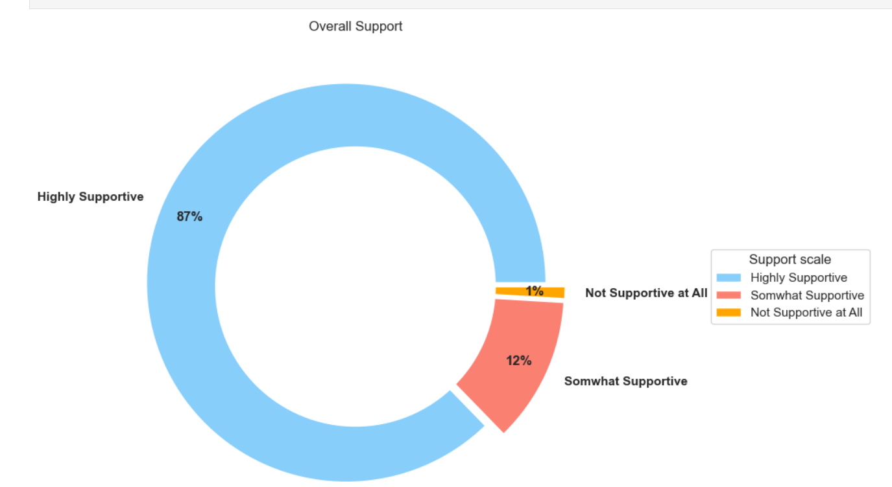
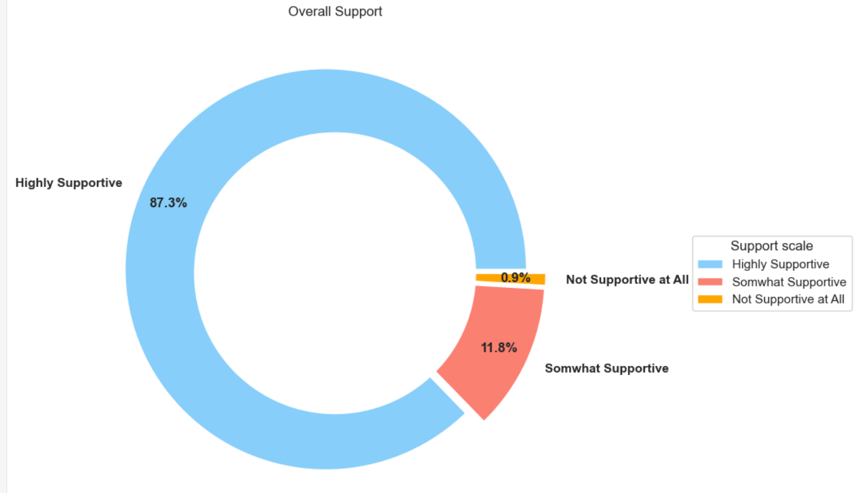
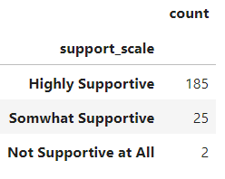
Support of Initiative

Slide 21
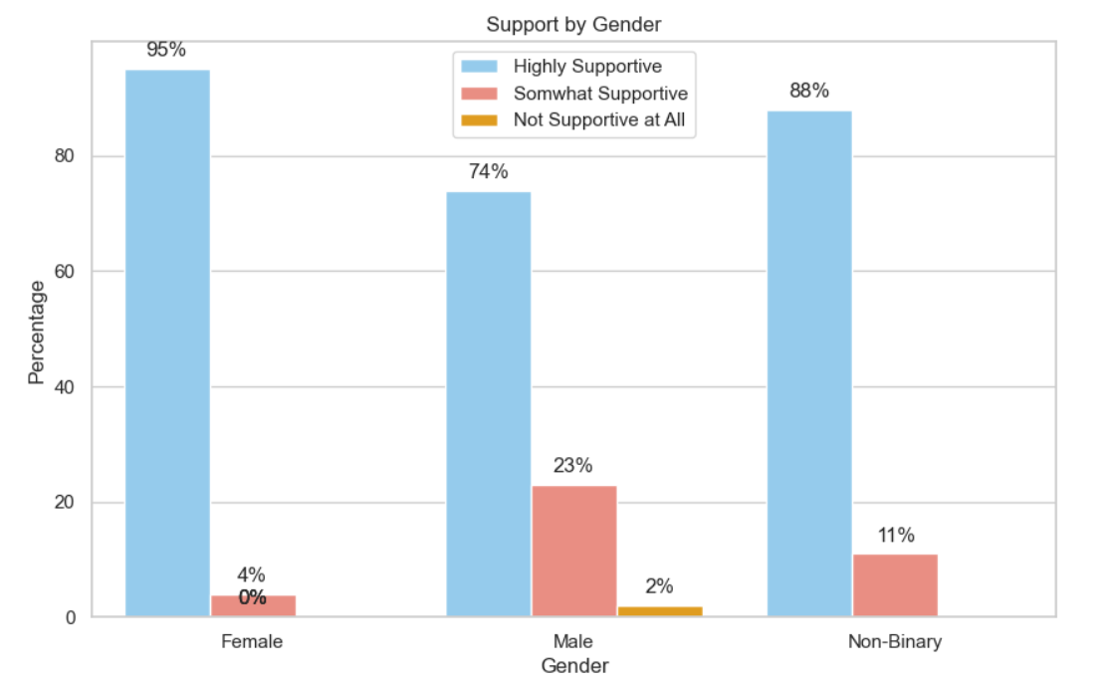
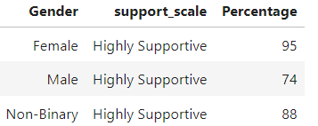
Support of Initiative
Majority of the students within each Gender is either somewhat or highly supportive of this initiative

Slide 22
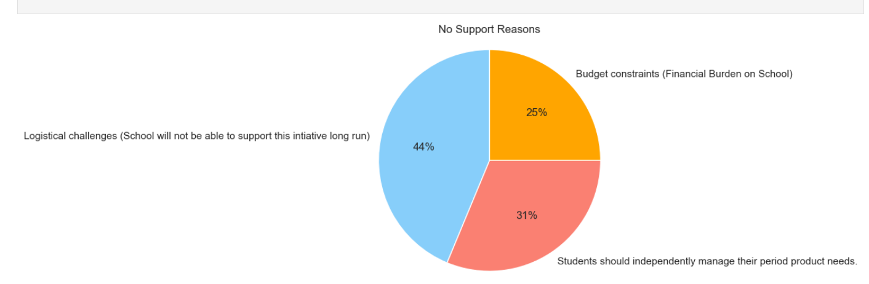
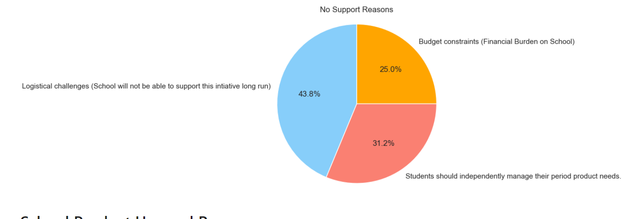
Reasons for No Support
Biggest concern
Logistical Challenge (Longrun Maintenance)

Slide 23
Students Concerns and Future Plans
Expansion
Quality
Improve Dispensing
Expand Options: super, pads, tampons,
(Budget Concern)

Slide 24

Conclusion

Slide 25
Appendix

Slide 26
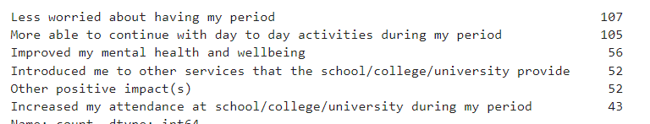
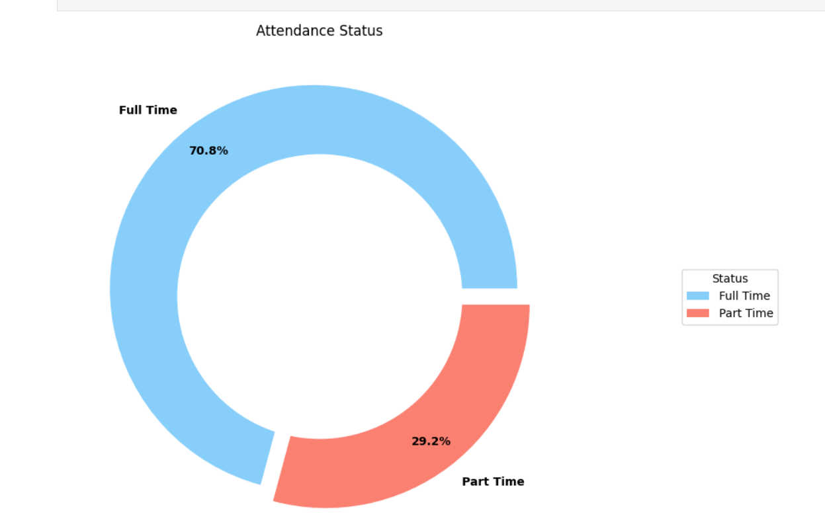
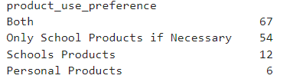
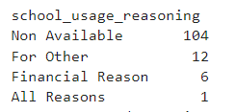
Attendance Status

Slide 27
